Slide 1
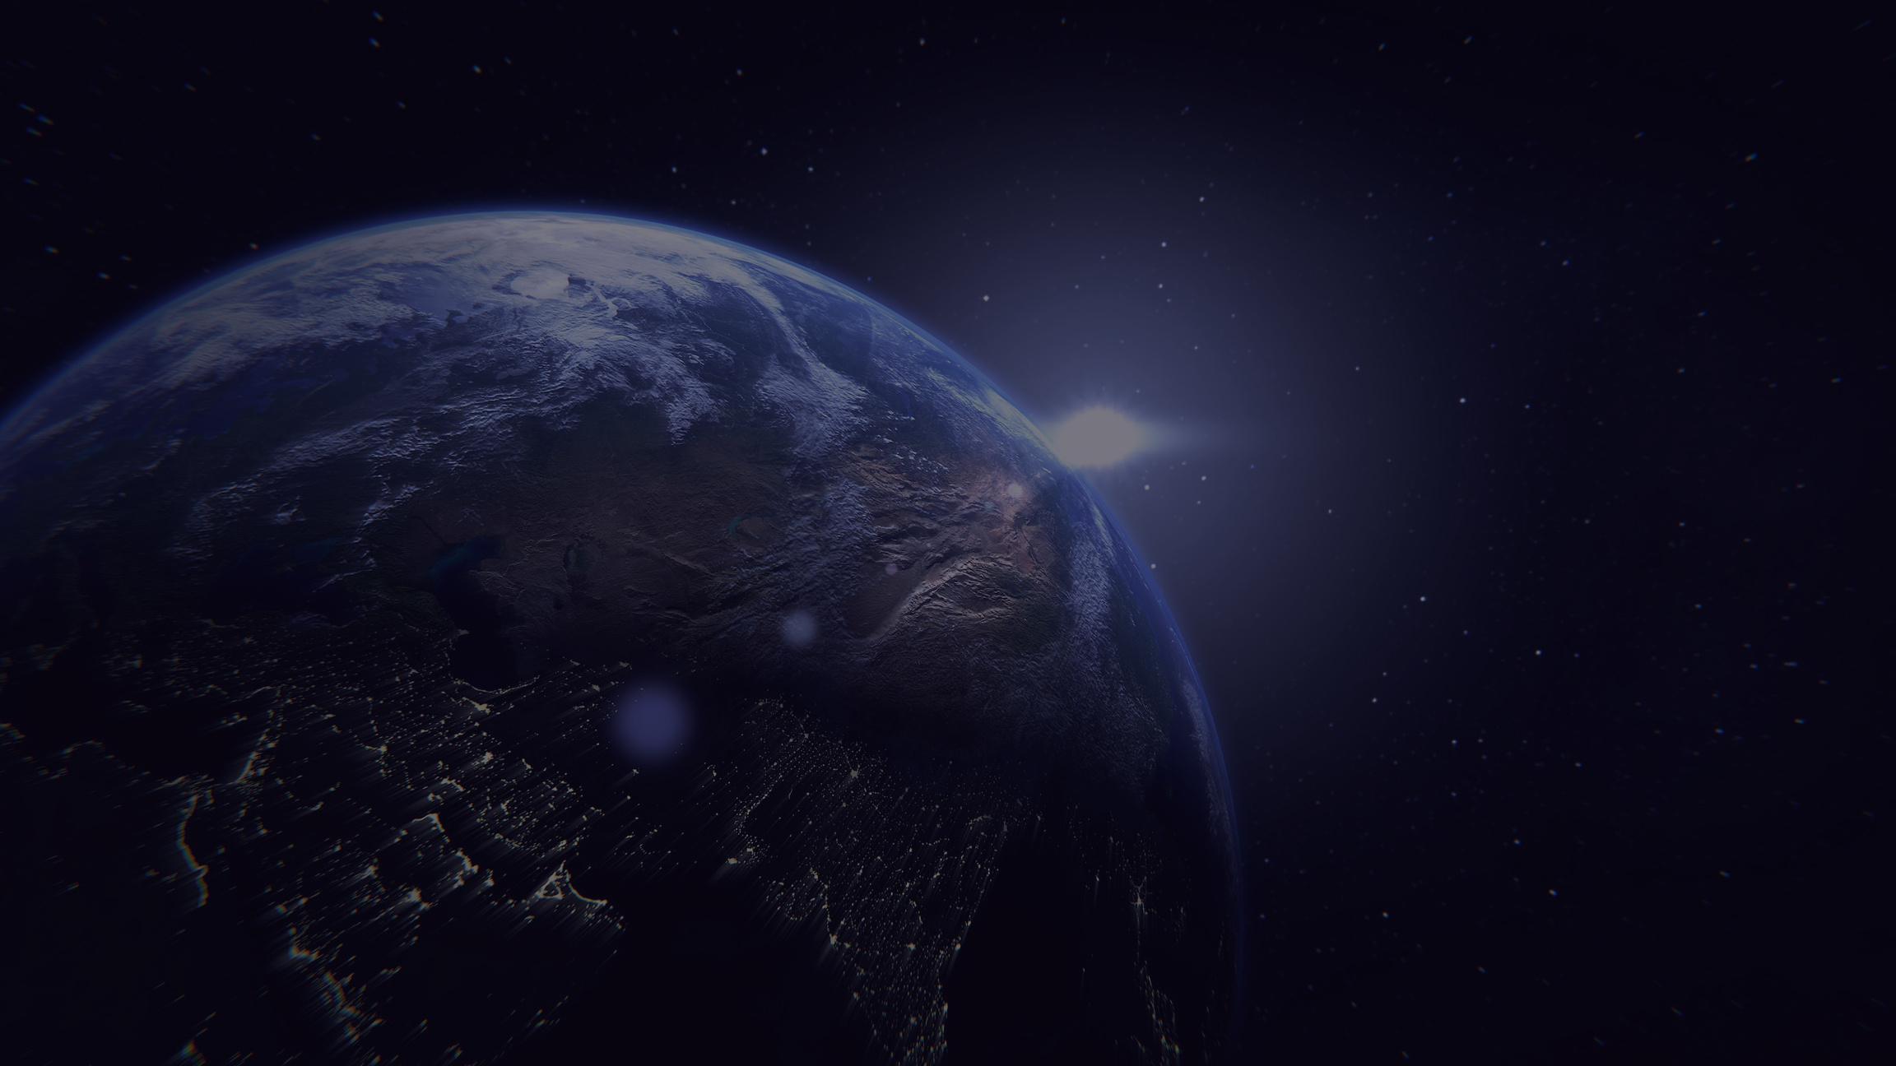




Second International Conference on
SPace, Aerospace & defenCE 2025
Paper Presentation
Paper id: #1571123857
Satellite Navigation and Control Using Discrete-APF and Fixed-Time Sliding Mode Controller
Author(s):
1. Paridhi D Choudhary
2. Rakesh Kumar Sahoo
3. Manoranjan Sinha
IEEE SPACE CONFERENCE 2025

Slide 2
Contents
Rigid Body Dynamic Model of Target Satellite
Rigid Body Dynamic Model of Chaser Satellite
Relative Kinematics and Dynamics of Satellite
Discrete-Artificial Potential Field
Design of Fixed-Time Sliding Mode Controller
Results and Discussions
Conclusion
IEEE SPACE CONFERENCE 2025

Slide 3
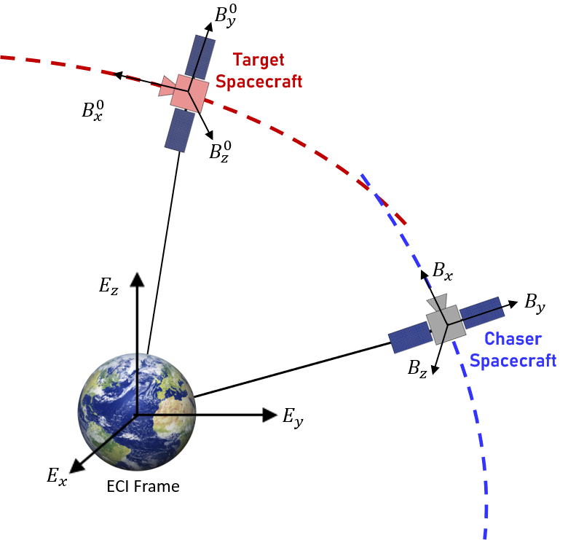
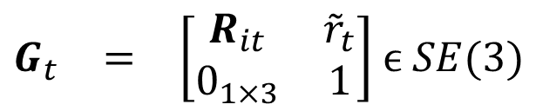
Rigid Body Dynamic Model of Target Satellite
The position, velocity and angular velocity of the target satellite in ECI frame is represented by ${\tilde{r}}_{t}$,${\tilde{v}}_{tb}$ and ${\tilde{Ω}}_{tb}$and $R_{it}$ represents the rotation matrix of target satellite wrt ECI frame.
The configuration of the target satellite on SE(3) manifold can be represented as 4×4 matrix
$\begin{matrix}G_{t} & = & \left[\begin{matrix}R_{it} & {\tilde{r}}_{t} \\ 0_{1×3} & 1\end{matrix}\right]\end{matrix} ϵ SE(3)$
(1)
The unified velocity vector of the angular velocity and translational velocity of the target satellite can be represented by $\begin{matrix}{\tilde{ξ}}_{tb} & = & {\left[\begin{matrix}{\tilde{Ω}}_{tb} ,{\tilde{v}}_{tb} \\ \end{matrix}\right]}^{T}\end{matrix} ϵ ℝ^{6}$
The kinematics of the target satellite can be represented as $\begin{matrix}{\dot{G}}_{t} & = & G_{t}{\tilde{ξ}}_{tb}^{∨}\end{matrix}$ (2)
Fig. 1 Rendezvous and Docking maneuver of chaser satellite with the target satellite
where ${\tilde{ξ}}_{tb}^{∨}$ is the exponential mapping of ${\tilde{ξ}}_{tb} : ℝ^{6} →se(3)$
IEEE SPACE CONFERENCE 2025

Slide 4
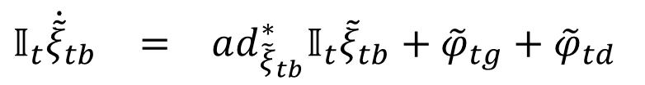
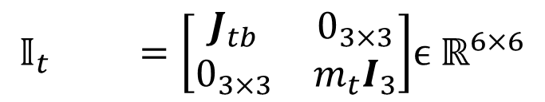
Rigid Body Dynamic Model of Target Satellite
Let the unified matrix of mass and inertia of target satellite be represented as,
$$\begin{matrix}𝕀_{t} & & =\left[\begin{matrix}J_{tb} & 0_{3×3} \\ 0_{3×3} & m_{t}I_{3}\end{matrix}\right]\end{matrix}ϵ ℝ^{6×6}$$
The coupled translational and rotational dynamics of the target satellite can be described using geometric mechanics as
$\begin{matrix}𝕀_{t}{\dot{\tilde{ξ}}}_{tb} & = & ad_{{\tilde{ξ}}_{tb}}^{∗}𝕀_{t}{\tilde{ξ}}_{tb}+{\tilde{φ}}_{tg}+{\tilde{φ}}_{td}\end{matrix}$
(3)
where
${\tilde{φ}}_{tg}$ and ${\tilde{φ}}_{td}$denotes the unified vector of gravitational force and gravity gradient torque, and the unified vector of external disturbance force and torque acting on the target satellite
Fig. 1 Rendezvous and Docking maneuver of chaser satellite with the target satellite
IEEE SPACE CONFERENCE 2025

Slide 5
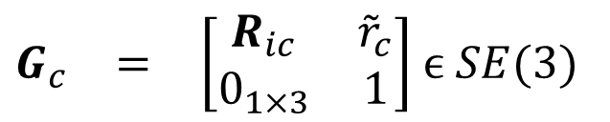
Rigid Body Dynamic Model of Chaser Satellite
The position, velocity and angular velocity of the chaser satellite in ECI frame is represented by ${\tilde{r}}_{c}$,${\tilde{v}}_{cb}$ and ${\tilde{Ω}}_{cb}$and $R_{ic}$ represents the rotation matrix of chaser satellite wrt ECI frame.
The configuration of the chaser satellite on SE(3) manifold can be represented as 4×4 matrix
$\begin{matrix}G_{c} & = & \left[\begin{matrix}R_{ic} & {\tilde{r}}_{c} \\ 0_{1×3} & 1\end{matrix}\right]\end{matrix} ϵ SE(3)$
(4)
The unified velocity vector of the angular velocity and translational velocity of the chaser satellite can be represented by $\begin{matrix}{\tilde{ξ}}_{cb} & = & {\left[\begin{matrix}{\tilde{Ω}}_{cb} ,{\tilde{v}}_{cb} \\ \end{matrix}\right]}^{T}\end{matrix} ϵ ℝ^{6}$
The kinematics of the chaser satellite can be represented as $\begin{matrix}{\dot{G}}_{c} & = & G_{c}{\tilde{ξ}}_{cb}^{∨}\end{matrix}$ (5)
Fig. 1 Rendezvous and Docking maneuver of chaser satellite with the target satellite
where ${\tilde{ξ}}_{cb}^{∨}$ is the exponential mapping of ${\tilde{ξ}}_{cb} : ℝ^{6} →se(3)$
IEEE SPACE CONFERENCE 2025

Slide 6
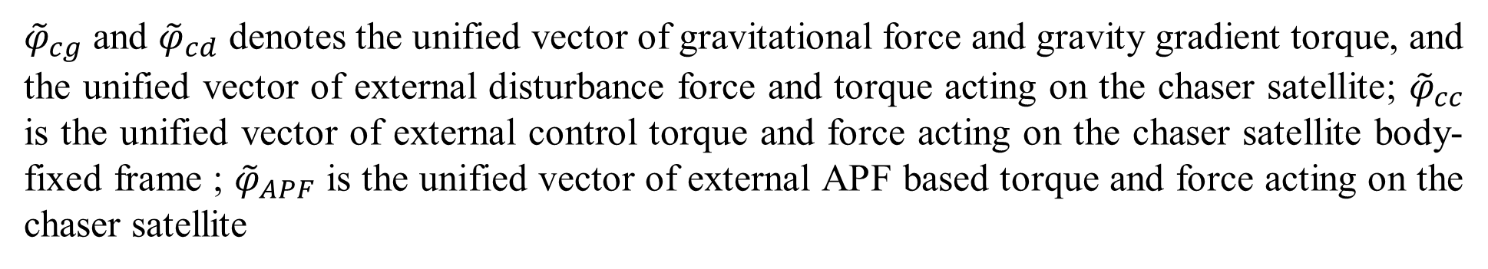
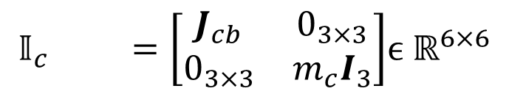
Rigid Body Dynamic Model of Chaser Satellite
Let the unified matrix of mass and inertia of chaser satellite be represented as,
$$\begin{matrix}𝕀_{c} & & =\left[\begin{matrix}J_{cb} & 0_{3×3} \\ 0_{3×3} & m_{c}I_{3}\end{matrix}\right]\end{matrix}ϵ ℝ^{6×6}$$
The coupled translational and rotational dynamics of the target satellite can be described using geometric mechanics as
$$\begin{matrix}𝕀_{c}{\dot{\tilde{ξ}}}_{cb} & = & ad_{{\tilde{ξ}}_{cb}}^{∗}𝕀_{c}{\tilde{ξ}}_{cb}+{\tilde{φ}}_{cc}+{\tilde{φ}}_{cg}+{\tilde{φ}}_{cd}+{\tilde{φ}}_{APF}\end{matrix}$$
(6)
where
${\tilde{φ}}_{cg}$ and ${\tilde{φ}}_{cd}$ denotes the unified vector of gravitational force and gravity gradient torque, and the unified vector of external disturbance force and torque acting on the chaser satellite; ${\tilde{φ}}_{cc}$ is the unified vector of external control torque and force acting on the chaser satellite body-fixed frame ; ${\tilde{φ}}_{APF}$ is the unified vector of external APF based torque and force acting on the chaser satellite
Fig. 1 Rendezvous and Docking maneuver of chaser satellite with the target satellite
IEEE SPACE CONFERENCE 2025

Slide 7
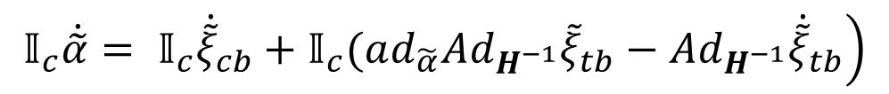
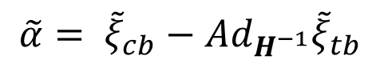
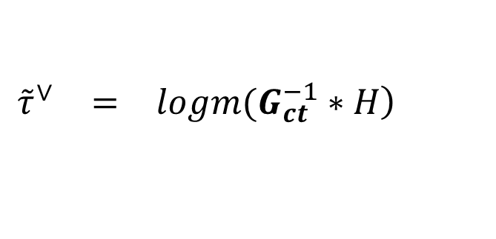
Relative Kinematics and Dynamics of Satellite
Relative configuration : $H={{\left(G_{t}\right)}^{−1}G}_{c} ϵ SE(3)$
where the desired configuration : $G_{ct} ϵ SE\left(3\right)$
The relative configuration tracking error vector $\tilde{τ}={\left[\begin{matrix}\tilde{γ} & \tilde{b}\end{matrix}\right]}^{T} ϵ ℝ^{6}$ consisting of orientation tracking error $\tilde{γ}$ and position racking error $\tilde{b}$, is obtained by performing logarithmic mapping $:SE\left(3\right) →se(3)$ as shown below.
$$\begin{matrix}{\tilde{τ}}^{∨} & = & \left.logm(G_{ct}^{−1}∗H\right)\end{matrix}$$
(7)
The relative velocity of the chaser satellite with respect to the target satellite in the chaser’s body-fixed frame is expressed as
$$\tilde{α}= {\tilde{ξ}}_{cb}−Ad_{H^{−1}}{\tilde{ξ}}_{tb}$$
(8)
The relative dynamics of chaser satellite with respect to the target satellite is expressed as
$$\left.𝕀_{c}\dot{\tilde{α}}= 𝕀_{c}{\dot{\tilde{ξ}}}_{cb}+𝕀_{c}(ad_{\tilde{α}}Ad_{H^{−1}}{\tilde{ξ}}_{tb}−Ad_{H^{−1}}{\dot{\tilde{ξ}}}_{tb}\right)$$
(9)
$$\begin{matrix}𝕀_{c}\dot{\tilde{α}} & = & \left.{\tilde{φ}}_{cg}+{\tilde{φ}}_{cd}+{\tilde{φ}}_{cc}+{\tilde{φ}}_{APF}+𝕀_{c}(ad_{{\tilde{ξ}}_{cb}}^{∗}𝕀_{c}{\tilde{ξ}}_{cb}+ad_{\tilde{α}}Ad_{H^{−1}}{\tilde{ξ}}_{tb}−Ad_{H^{−1}}{\dot{\tilde{ξ}}}_{tb}\right)\end{matrix}$$
(10)
IEEE SPACE CONFERENCE 2025

Slide 8
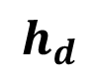

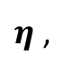
Proposed Control Architecture
$$h_{d}$$
Coupled Relative Kinematics and Dynamics Model
Lie group SE(3)
Delaunay
Triangulation
$η$ ,
Artificial
Potential Field
Fixed-Time
Sliding mode Controller
Control
Input
Kinematics Model
Dynamics Model
$$ξ$$
External Disturbances
Fig. 2 Proposed architecture of collision-free path planning using Discrete APF and Fixed-Time SMC
IEEE SPACE CONFERENCE 2025

Slide 9
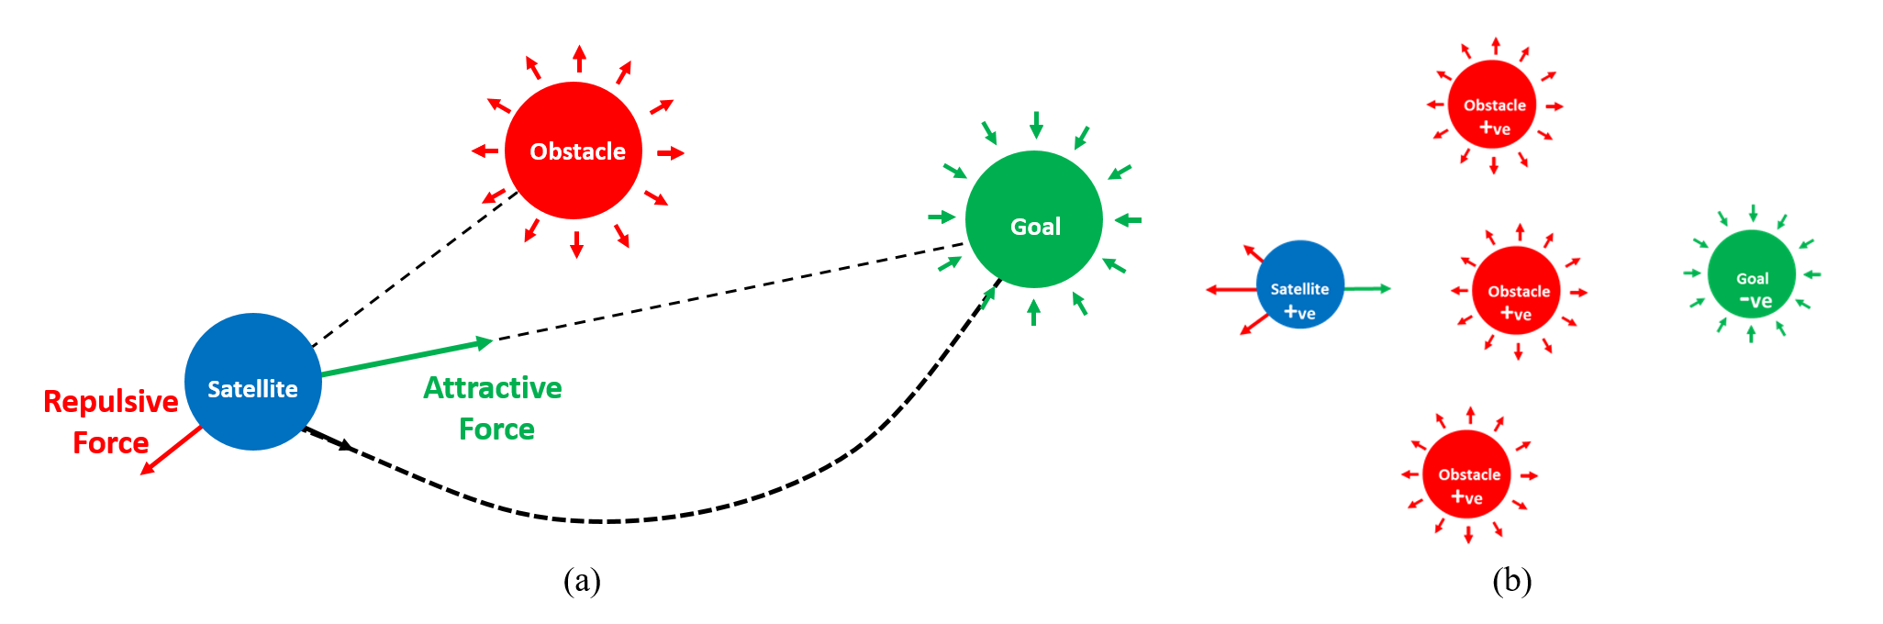
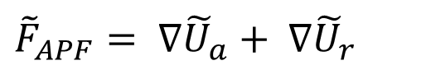
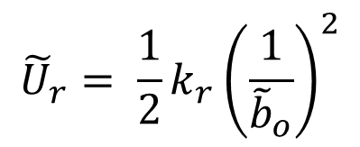
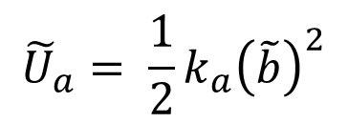
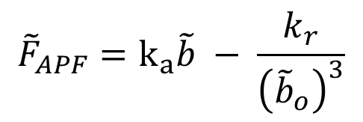
Artificial Potential Field Algorithm
The expression of attractive potential is a quadratic function of relative position of chaser satellite w.r.t target satellite,
$${\tilde{U}}_{a}= \frac{1}{2}k_{a}{\left(\tilde{b}\right)}^{2}$$
The expression of repulsive potential of obstacle as a function of relative position of chaser satellite w.r.t obstacle,
Fig. 3 Illustration of (a) Path planning using APF (b) Local minima scenario in presence of multiple obstacles
$${\tilde{U}}_{r}= \frac{1}{2}k_{r}{\left(\frac{1}{{\tilde{b}}_{o}}\right)}^{2}$$
The resultant force ${\tilde{F}}_{APF}$ acting on the satellite is derived from the gradient of the respective potential function
${\tilde{F}}_{APF}= ∇{\tilde{U}}_{a}+ ∇{\tilde{U}}_{r}$
$${\tilde{F}}_{APF}=k_{a}\tilde{b} − \frac{k_{r}}{{\left({\tilde{b}}_{o}\right)}^{3}}$$
IEEE SPACE CONFERENCE 2025

Slide 10
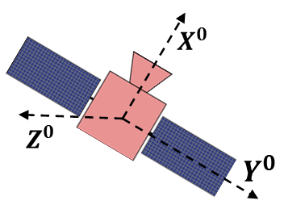
Discrete - Artificial Potential Field Algorithm
Goal
Obstacle
Fig. 4 Illustration of satellite motion through the obstacles using the proposed D-APF approach
Delaunay triangulation is a geometric-based approach used to divide a set of points in a plane into non-overlapping triangles, ensuring no other points lie within the circumcircle of each triangle.
Instead of considering the cumulative repulsive force from all obstacles, the algorithm focuses only on the two nearest obstacles at any instant determined using Delaunay triangulation based geometric method.
IEEE SPACE CONFERENCE 2025

Slide 11
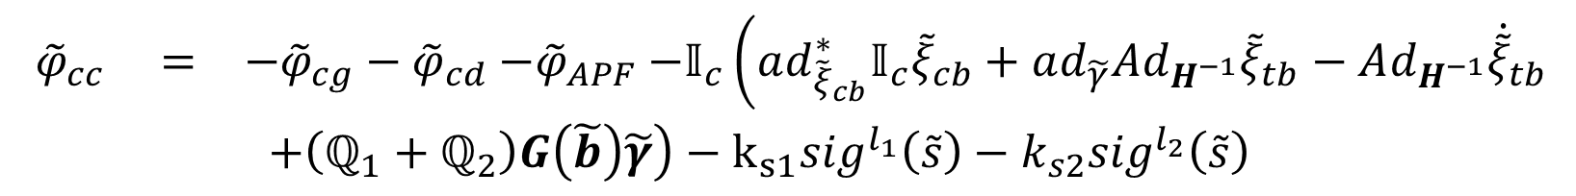
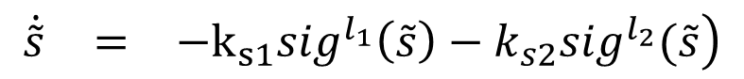
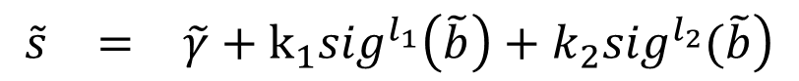
Fixed-Time Sliding Mode Controller
The fixed-time sliding surface consisting of the exponential coordinate vectors, $\tilde{b}$ and relative velocity, $\tilde{γ}$ to track the desired trajectory within fixed time is defined as
$$\begin{matrix}\tilde{s} & = & \left.\tilde{γ}+k_{1}{sig}^{l_{1}}\left(\tilde{b}\right)+k_{2}{sig}^{l_{2}}(\tilde{b}\right)\end{matrix}$$
(11)
where
$k_{1},k_{2}>0$, $0<l_{1}≤1$, $l_{2}>1$, $\tilde{s}=\left[s_{1},s_{2},…,s_{6}\right]ϵ ℝ^{6}$, $\tilde{γ}=\left[γ_{1},γ_{2},…,γ_{6}\right]ϵ ℝ^{6}$ and $\tilde{ρ}=\left[b_{1},b_{2},…,b_{6}\right]ϵ ℝ^{6}$.
A fixed-time reaching law based control law to ensure that the system states to reach the sliding surface within fixed time is defined as
$$\begin{matrix}\dot{\tilde{s}} & = & \left.−k_{s1}{sig}^{l_{1}}\left(\tilde{s}\right)−k_{s2}{sig}^{l_{2}}(\tilde{s}\right)\end{matrix}$$
(12)
Consider the fixed time control input is defined as,
$$\begin{matrix}{\tilde{φ}}_{cc} & = & −{\tilde{φ}}_{cg}−{\tilde{φ}}_{cd}{−\tilde{φ}}_{APF}−𝕀_{c}\left(ad_{{\tilde{ξ}}_{cb}}^{∗}𝕀_{c}{\tilde{ξ}}_{cb}+ad_{\tilde{γ}}Ad_{H^{−1}}{\tilde{ξ}}_{tb}−Ad_{H^{−1}}{\dot{\tilde{ξ}}}_{tb}\right. \\ & & {\left.+\left(ℚ_{1}+ℚ_{2}\right)G\left(\tilde{b}\right)\tilde{γ}\right)−k}_{s1}{sig}^{l_{1}}\left(\tilde{s}\right)−k_{s2}{sig}^{l_{2}}\left(\tilde{s}\right) \end{matrix}$$
(13)
IEEE SPACE CONFERENCE 2025

Slide 12
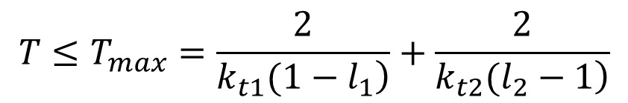
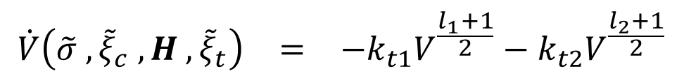
Fixed-Time Sliding Mode Controller
A continuous differentiable Lyapunov function is defined as, $V\left(\tilde{σ} ,{\tilde{ξ}}_{c} , H , {\tilde{ξ}}_{t}\right)= \frac{1}{2} {\tilde{s}}^{T}𝕀_{c}\tilde{s}$
(14)
Performing the time derivative of Lyapunov function and using the control input,
$$\begin{matrix}\dot{V}\left(\tilde{σ} ,{\tilde{ξ}}_{c} , H , {\tilde{ξ}}_{t}\right) & = & −k_{t1}V^{\frac{l_{1}+1}{2}}−k_{t2}V^{\frac{l_{2}+1}{2}}\end{matrix}$$
(15)
where $k_{t1}=\left(2^{\frac{l_{1}+1}{2}}\right)λ_{min}\left(k_{s1}\right)$ and $k_{t2}= {\left(2^{\frac{l_{1}+1}{2}}\right)\left(6^{\frac{l_{2}−1}{2}}\right)∗λ}_{min}(k_{s2})$
Therefore, the system states will reach the desired sliding surface $\tilde{s}=0$within fixed-time, $T_{max}$
$$T≤T_{max}=\frac{2}{\left.k_{t1}(1−l_{1}\right)}+\frac{2}{\left.k_{t2}(l_{2}−1\right)}$$
(16)
IEEE SPACE CONFERENCE 2025

Slide 13
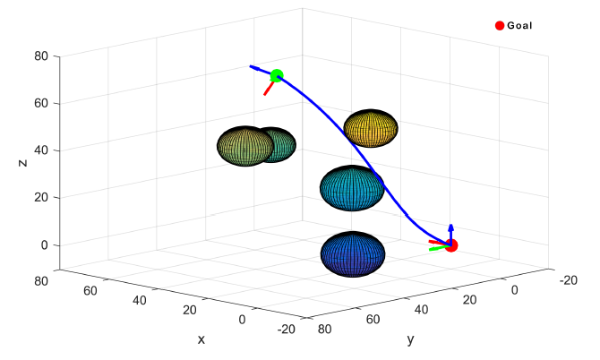
Simulation Results
Fig. 5 Illustration of collision-free trajectory of chaser satellite using D-APF
IEEE SPACE CONFERENCE 2025

Slide 14
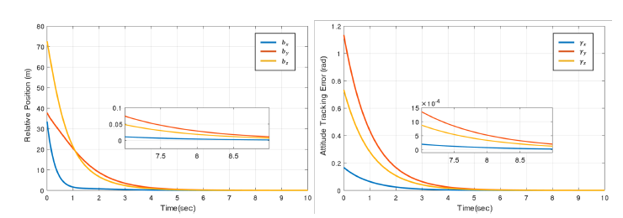
Simulation Results
Fig. 6 Plot of Configuration Tracking error (a) Relative Position (left) (b) Attitude tracking error (right)
IEEE SPACE CONFERENCE 2025

Slide 15
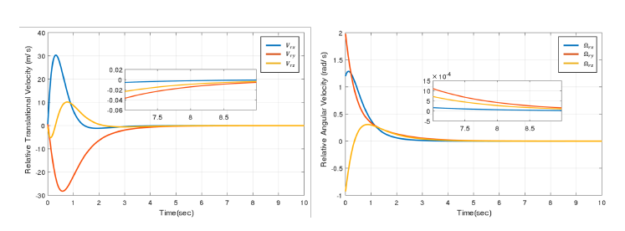
Results
Fig. 7 Plot of Relative Velocity error (a) Translational (left) (b) Rotational (right)
IEEE SPACE CONFERENCE 2025

Slide 16
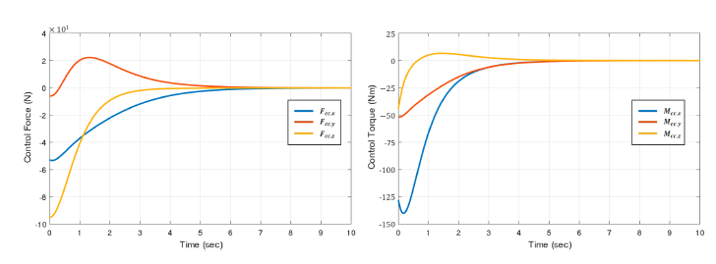
Simulation Results
Fig. 8 Plot of Control Input (a) Control Force (left) (b) Control Moment (right)
IEEE SPACE CONFERENCE 2025

Slide 17
Thank You
IEEE SPACE CONFERENCE 2025

